Slide 1

Web Application Development
COMP-229

Slide 2
DEPLOYMENT
Deploying your application using Netlify.

Slide 3
Go to the terminal cd into the application folder (i.e client) and run the command npm run build
Notice it will create a dist folder
Go to your Netlify account if you don’t have one create one or sign in if you already have an account
Click on add new site
Click on manual deploy
Go to your vscode right click on dist folder, click on reveal in File Explorer
Click and drag that folder i.e the dist folder into Netlify
After the deployment if successful it will show the domain name
Click on it and it will show your project.

Slide 4
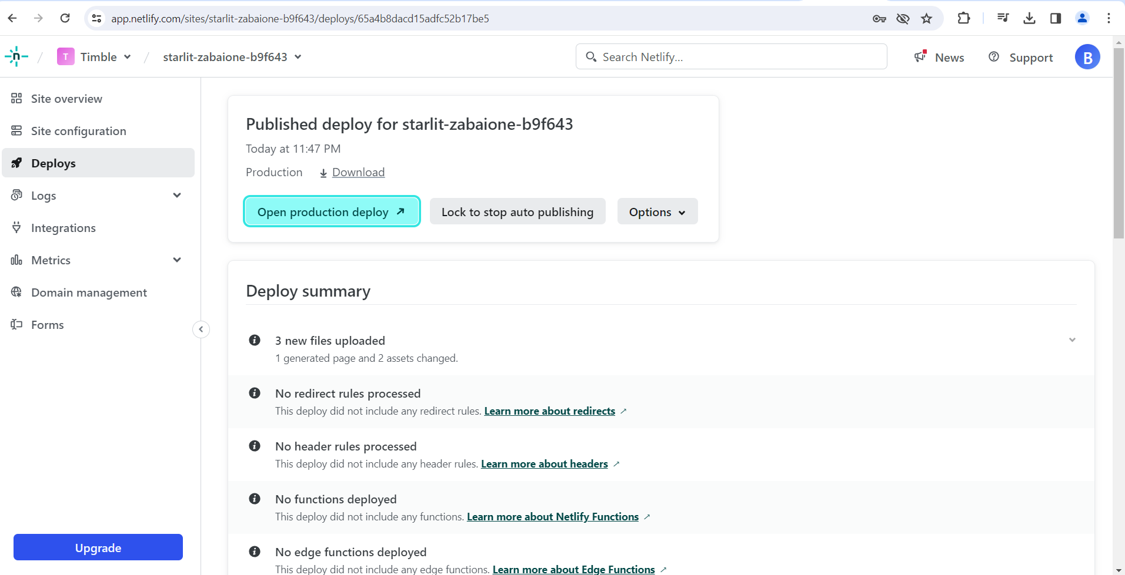

Slide 5
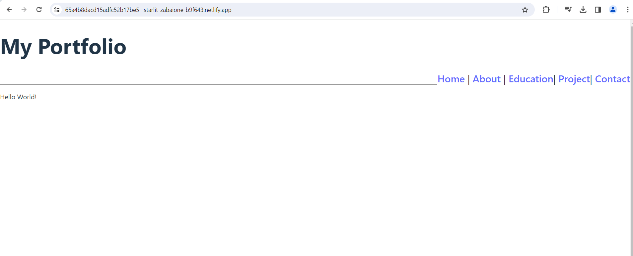
https://65a4b8dacd15adfc52b17be5--starlit-zabaione-b9f643.netlify.app/

